Slide 1
Application of additive manufacturing technology for the production of injection molding tools in order to reduce the cycle time
Zoltán Takács, Imre Kállai
8th INTERNATIONAL SCIENTIFIC CONFERENCE ON ADVANCES IN MECHANICAL ENGINEERING
(ISCAME 2022)
10-11 November, 2022 Debrecen, Hungary
GINOP-2.1.2-8-1-4-16-2017-00430

Slide 2
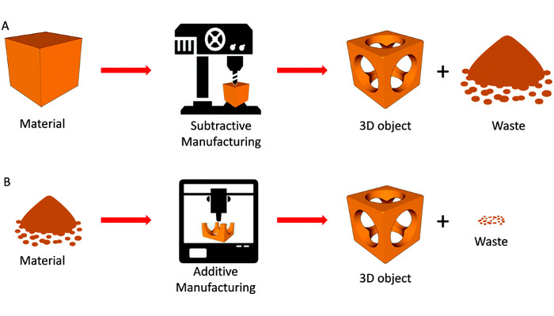
What is additive manufacturing?
Additive manufacturing – defined by ASTM International (ASTM 2792 12):
Additive manufacturing is a process of joining materials to make objects from three dimensional data, usualy layer upon layer, as opposed to substractive manufacturing methodologies.
GINOP-2.1.2-8-1-4-16-2017-00430

Slide 3
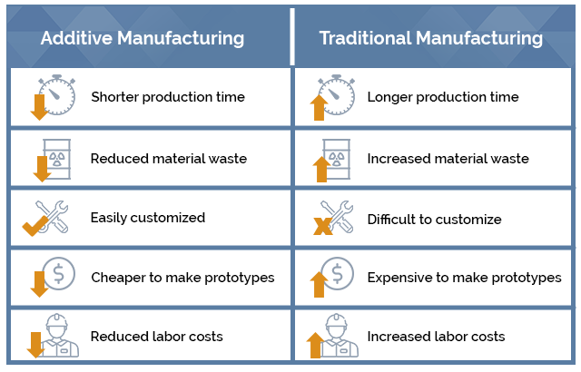
additive manufacturing vs Traditional Manufacturing
GINOP-2.1.2-8-1-4-16-2017-00430

Slide 4
additive manufacturing technologies
GINOP-2.1.2-8-1-4-16-2017-00430

Slide 5
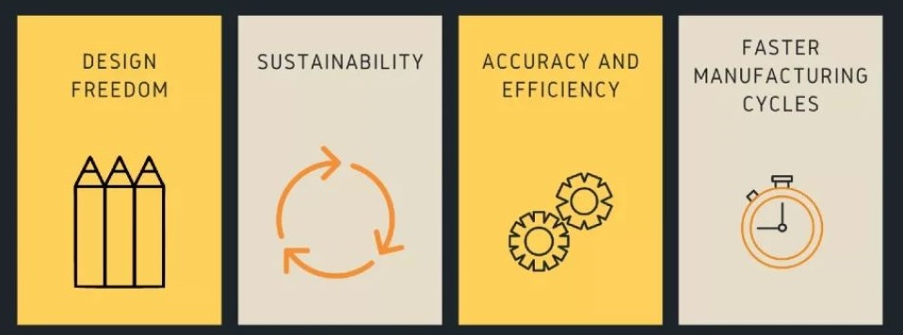
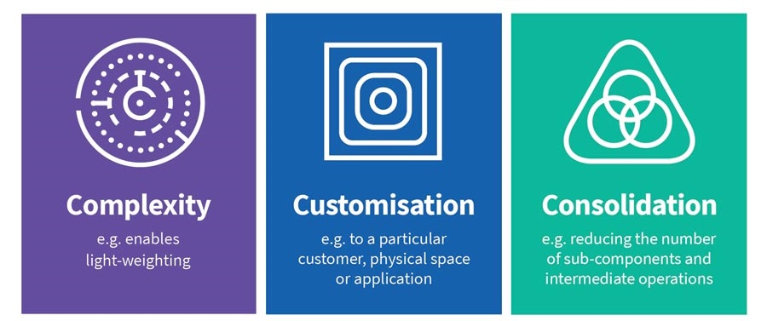
Benefits of additive Manufacturing
GINOP-2.1.2-8-1-4-16-2017-00430

Slide 6
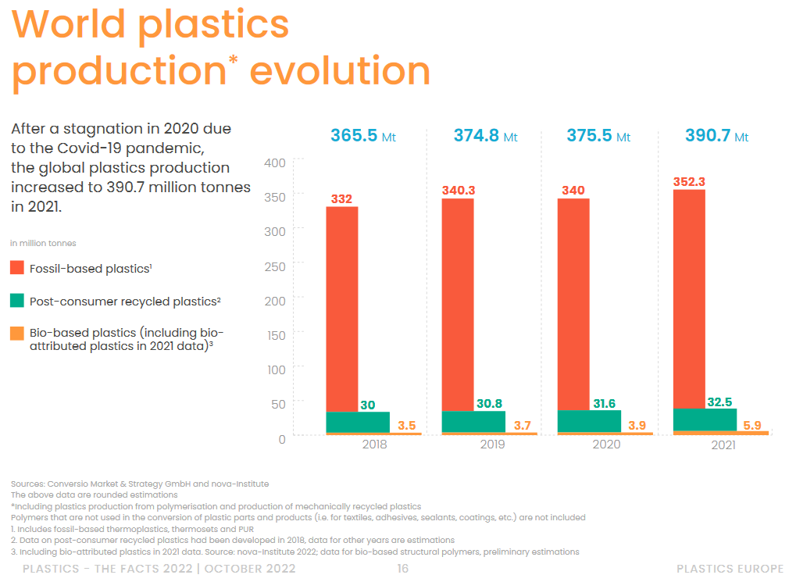
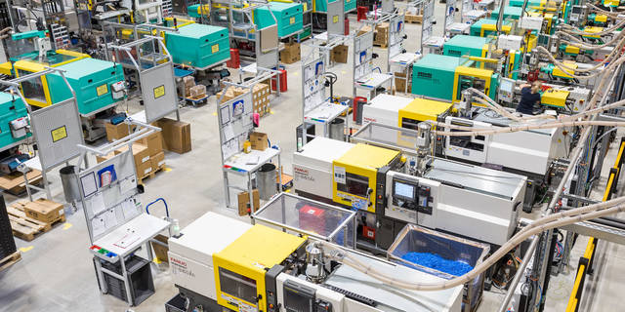
Benefits of additive Manufacturing – how can we use it?
GINOP-2.1.2-8-1-4-16-2017-00430

Slide 7
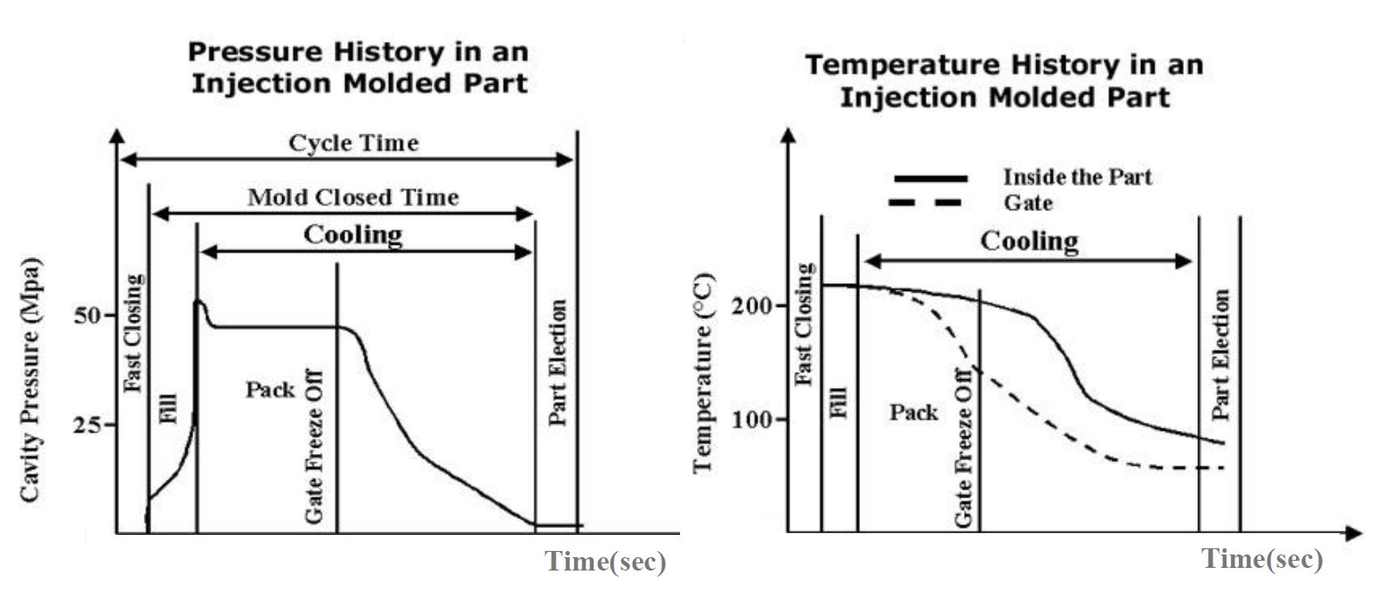
Injection molding cycle
GINOP-2.1.2-8-1-4-16-2017-00430

Slide 8
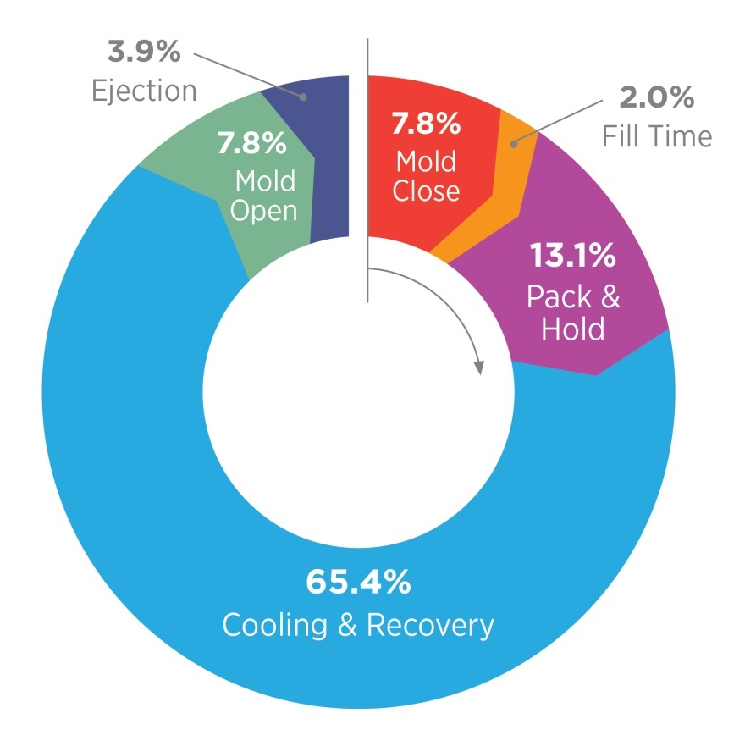
Injection molding – process cycle
Rapid Heat/Cool Technology
CONFORMAL COOLING TOOL
GINOP-2.1.2-8-1-4-16-2017-00430

Slide 9
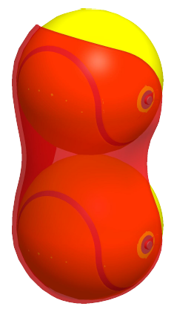
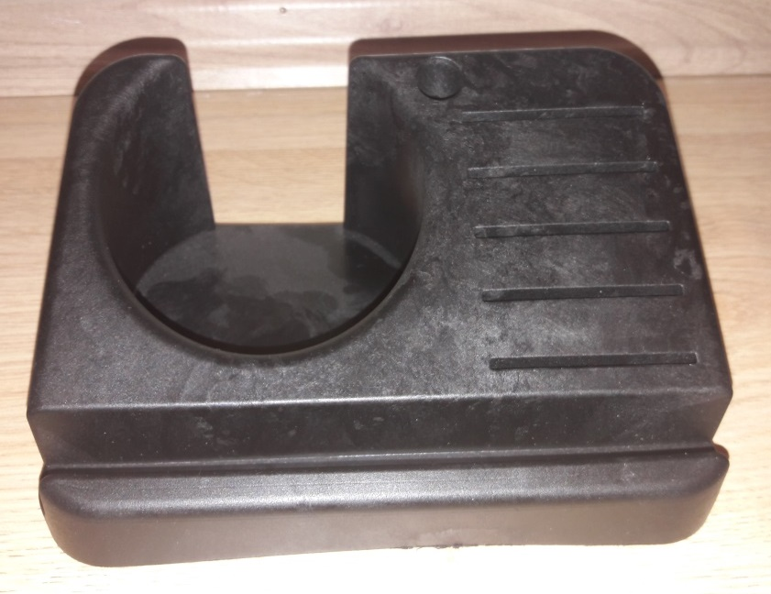
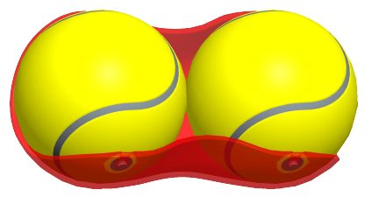
The test products
Main goal
Complex surface design
GINOP-2.1.2-8-1-4-16-2017-00430

Slide 10
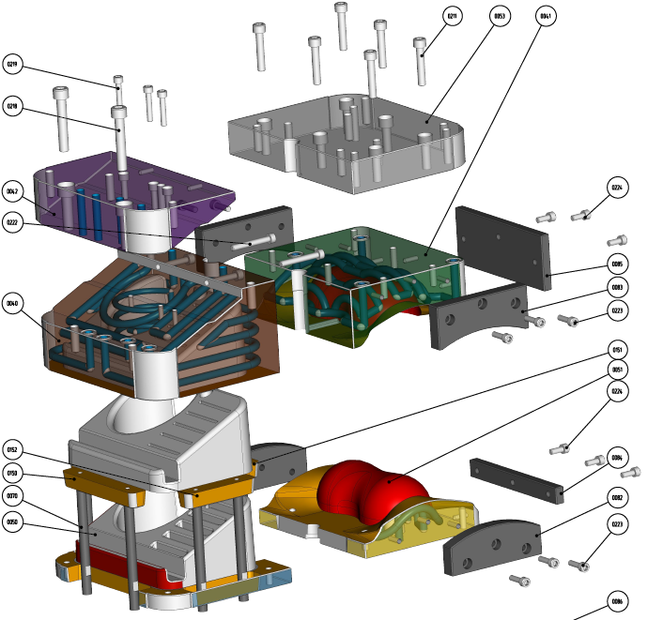
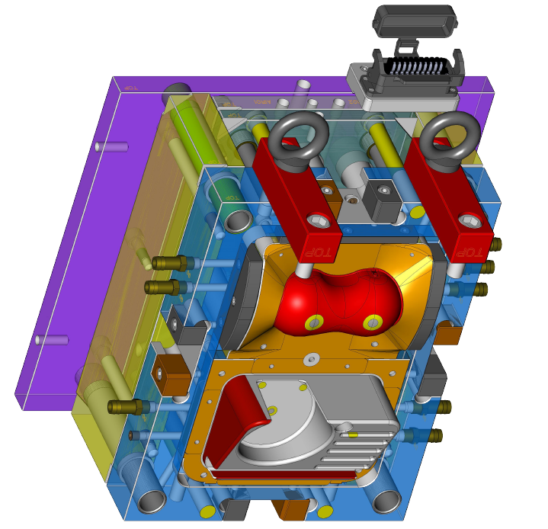
Tool and Cooling chanel desig
GINOP-2.1.2-8-1-4-16-2017-00430

Slide 11
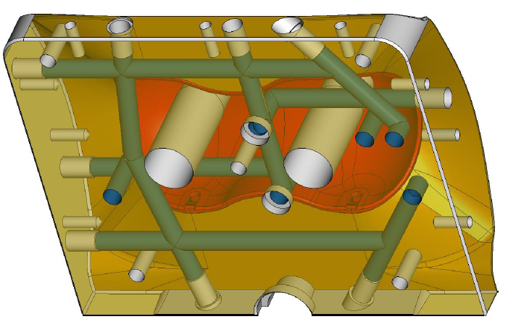
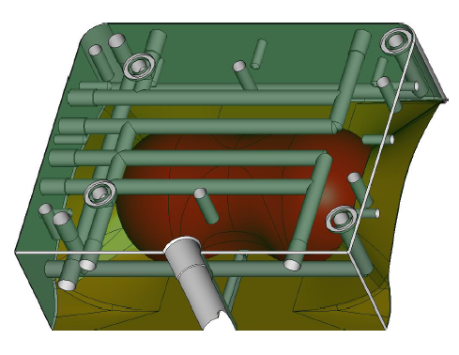
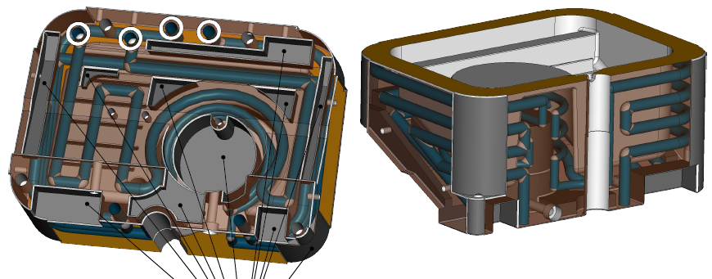
Normal and conformal Cooling chanel desig
GINOP-2.1.2-8-1-4-16-2017-00430

Slide 12
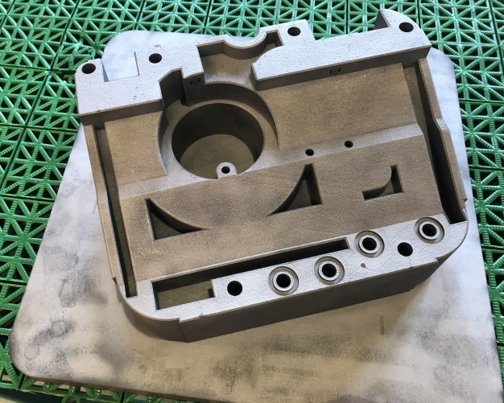
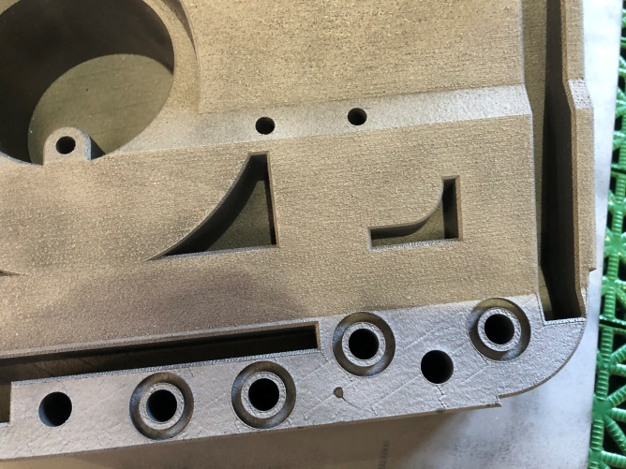
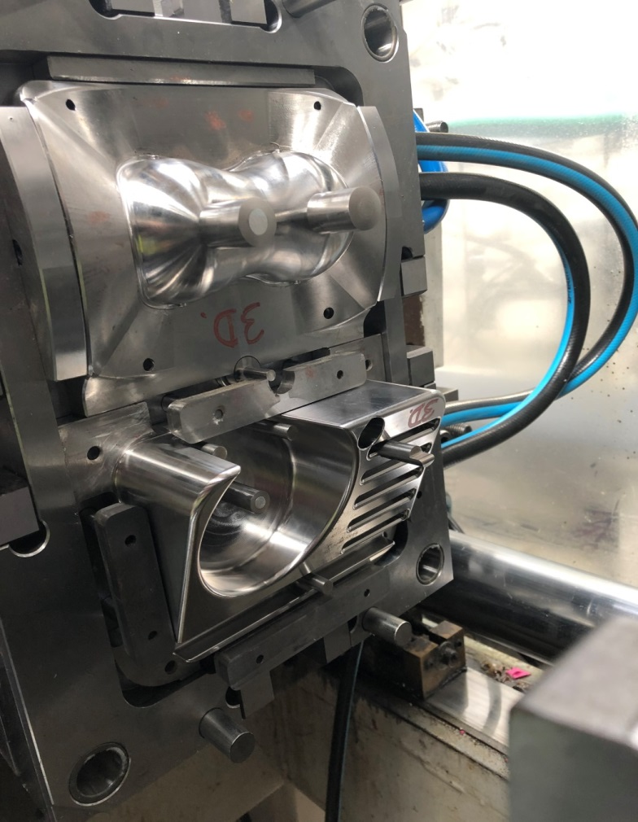
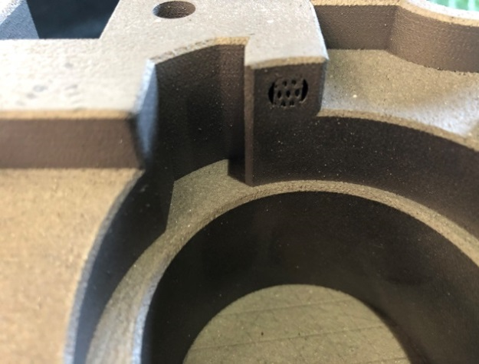
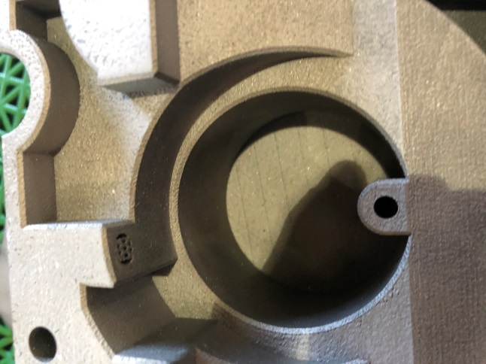
tool insert produced with additive manufacturing technology
AFTER 3D PRINTING → SURFACE MACHINING → COMPLETE TOOL
GINOP-2.1.2-8-1-4-16-2017-00430

Slide 13
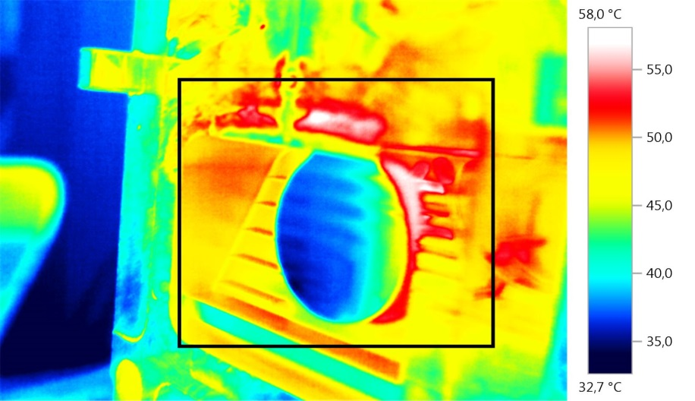
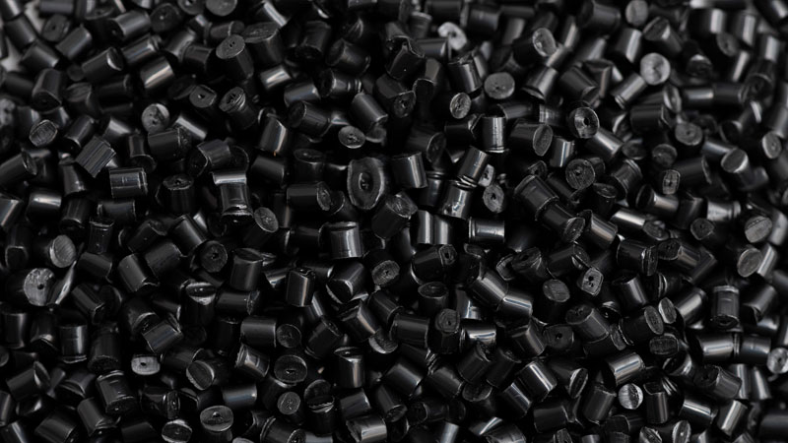
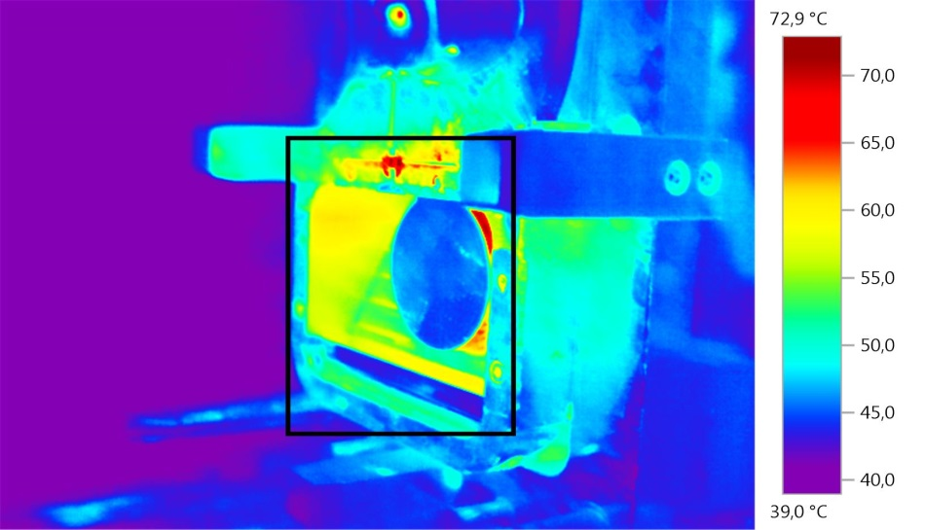
injection molding manufacturing test
Material:
PP
PA 6
PA 6 30 GF
Cooling chanel type | Cooling chanel diameter, mm
Conventional V1 | 6
Additiv - Conformal V1 | 6
Conventional V4 | 8
Additiv - Conformal V4 | 8
Conventional V7 | 12
Additiv - Conformal V7 | 12
CONVENTIONAL TOOL
CONFORMAL TOOL
GINOP-2.1.2-8-1-4-16-2017-00430

Slide 14
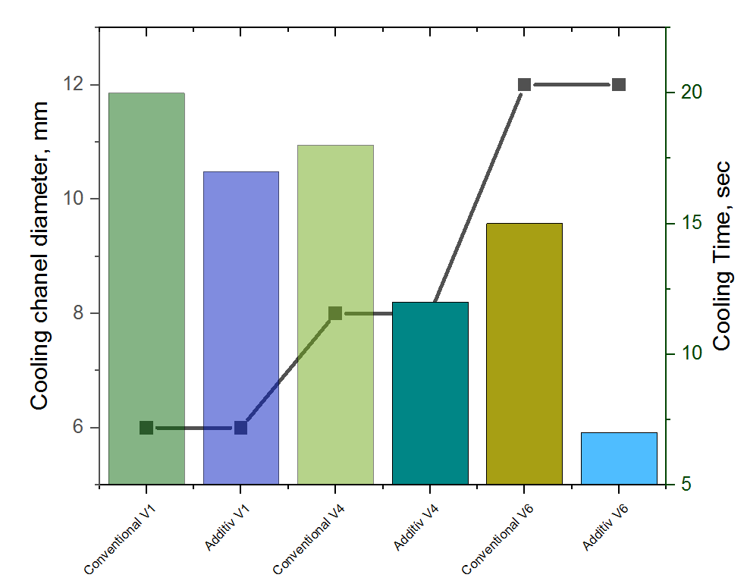
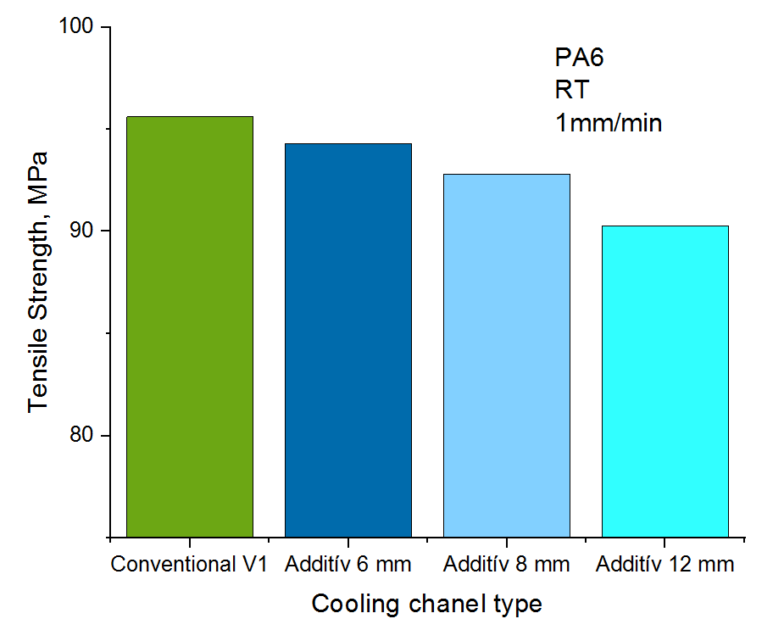
injection molding test RESULTS
+ Cooling time was reduced from 20 sec to 7 sec (-65%)
+ 3D printed tool was 15% lighter compare to the conventional one
- Tensile Strength was decreasing with 5,6%
GINOP-2.1.2-8-1-4-16-2017-00430

Slide 15
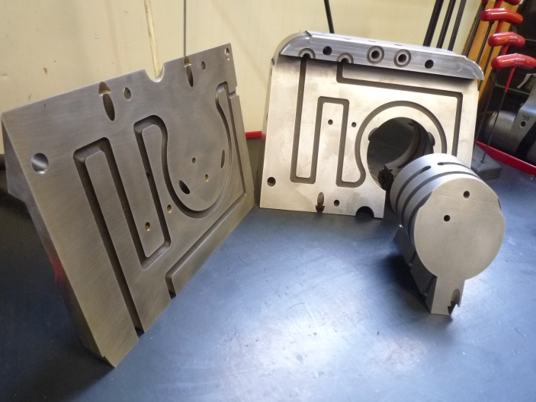
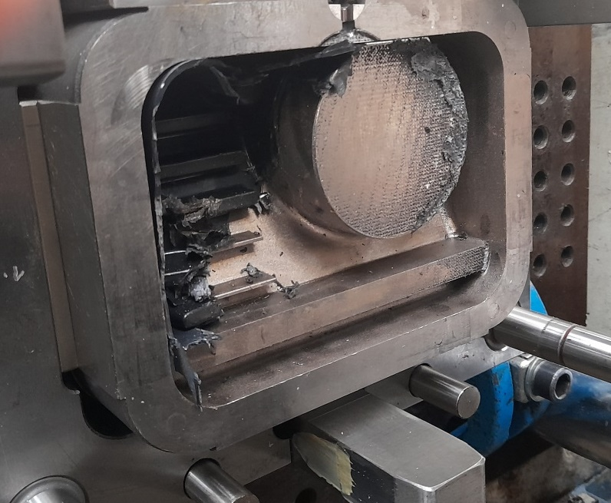
Interesting pictures
GINOP-2.1.2-8-1-4-16-2017-00430

Slide 16
GINOP-2.1.2-8-1-4-16-2017-00430

Slide 17
Thank you
for
your
Attention!
GINOP-2.1.2-8-1-4-16-2017-00430

